Slide 1
Time series Project
Temperature Prediction of Austin
Akshay Kumar Varanasi

Slide 2
Outline
About the data
Stationary Model
Stationary Model Forecast (1-step rolling)
Non-Stationary Model
Non-Stationary Model Forecast (1-step rolling)
ARMAV
ARMAV (1-step rolling)
Conclusion

Slide 3
Overview of the data
Accurate weather prediction is important for planning our day to day activities.
In our case, we are predicting Temperature (whether it will be cool or hot tomorrow? Do we need to wear sweater or T-shirt?)
Austin Weather Dataset from Kaggle was used which was obtained from WeatherUnderground.com, at the Austin KATT station. https://www.kaggle.com/grubenm/austin-weather
This dataset contains data for every date from 2013-12-21 to 2017-07-31. (1319 data points)
For training we used 50% data, which is around 660 data points and validated on the remaining data.

Slide 4
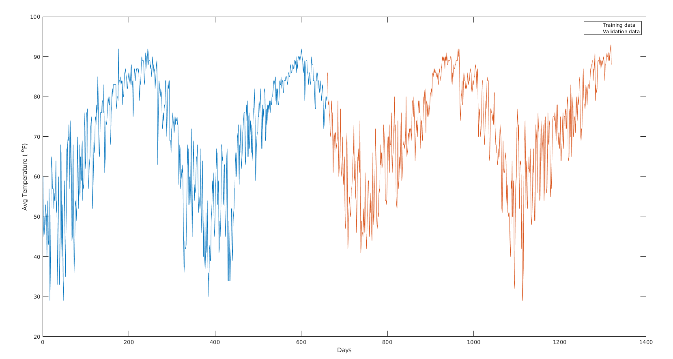
Temperature Data of Austin

Slide 5
Stationary Model
ARMA(2n,2n-1) Technique, F-test was used
ARMA(6,3) model was found adequate with RSS was 1.7312e+04

Slide 6
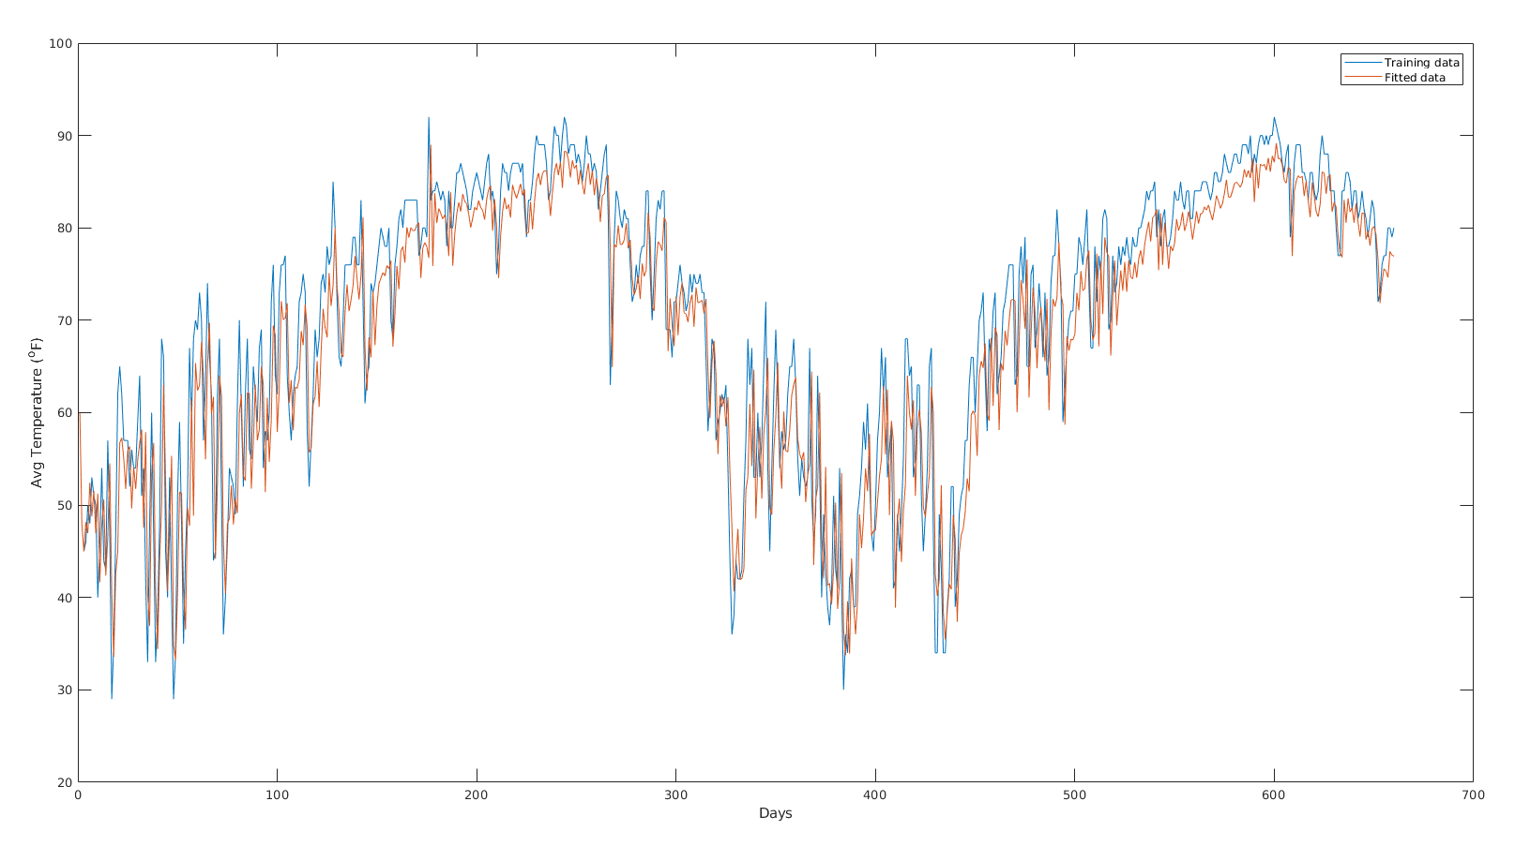
Stationary Model

Slide 7
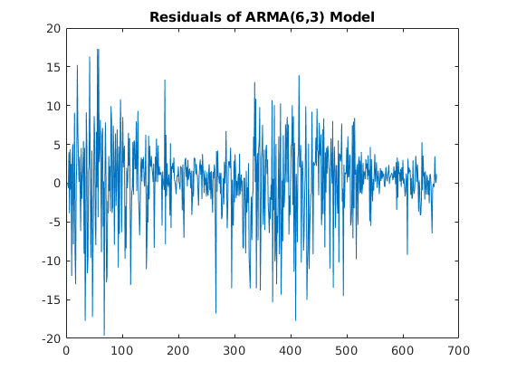
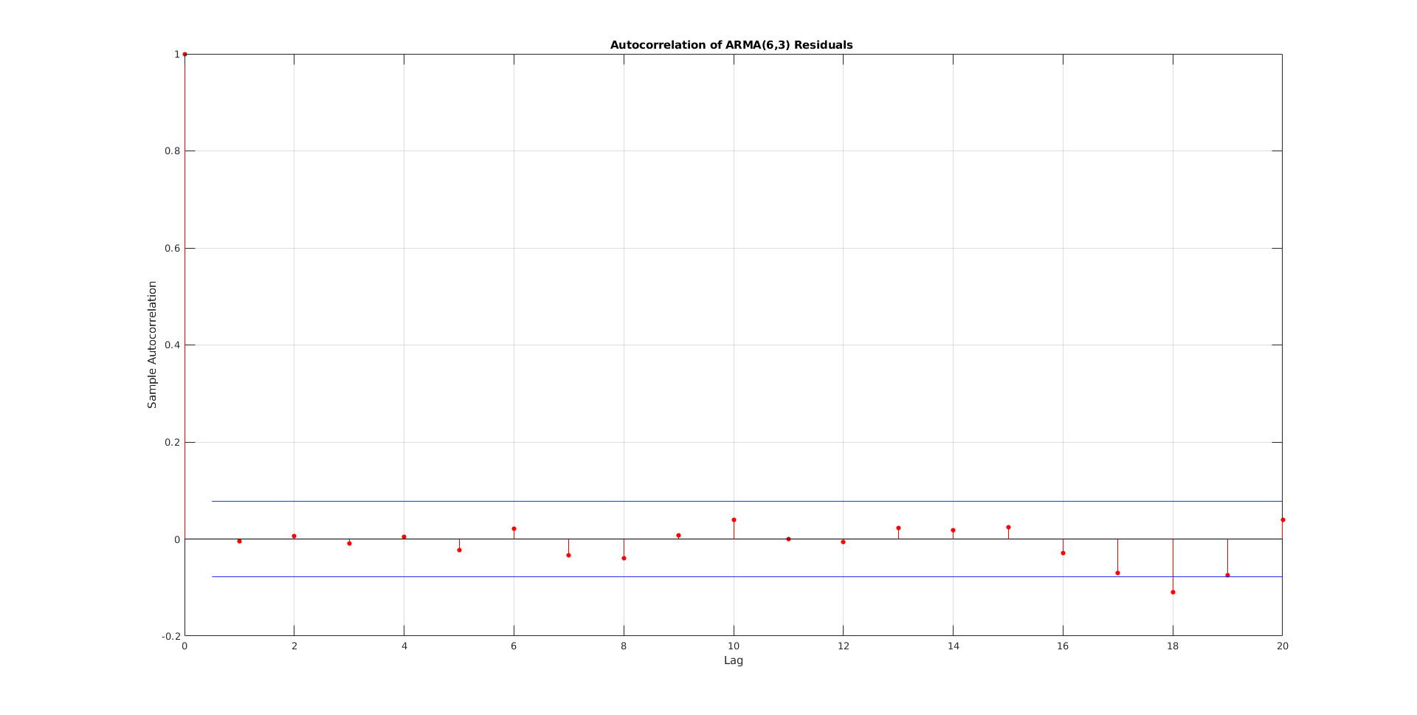
Residual plot

Slide 8
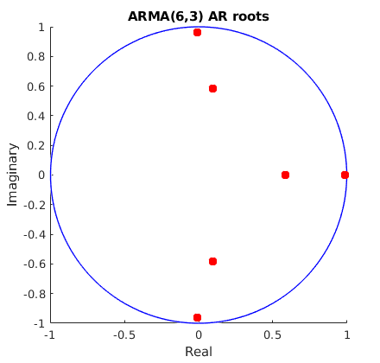
Auto-regressive roots
Out of 6 roots, 2 roots are real and 4 are complex.
1 root is 0.9903 ≅ 1 so stochastic trend was checked it was found that it exits. RSS=1.7374e+04
Complex roots give period 3.9748 ≅ 4 and 4.4614 ≅ 4.5. Seasonality was checked and it was found that it does not exists.

Slide 9
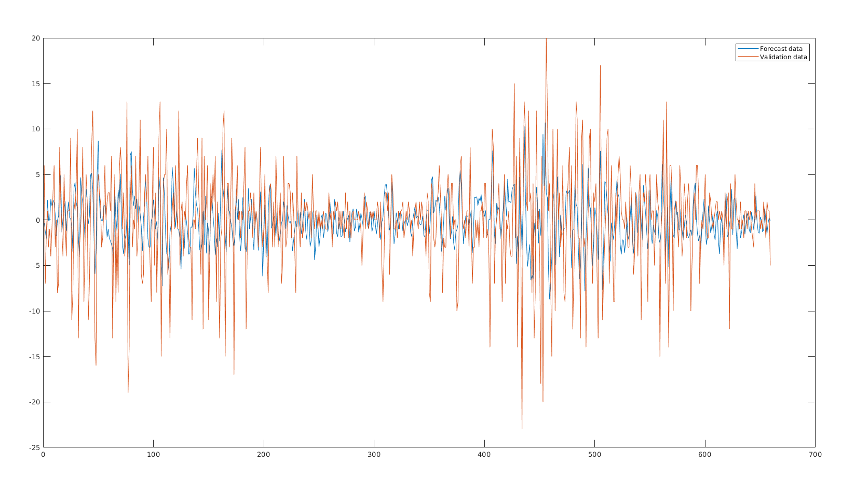
Forecast
The model used was that of parsimonious one i.e ARMA(5,3).

Slide 10
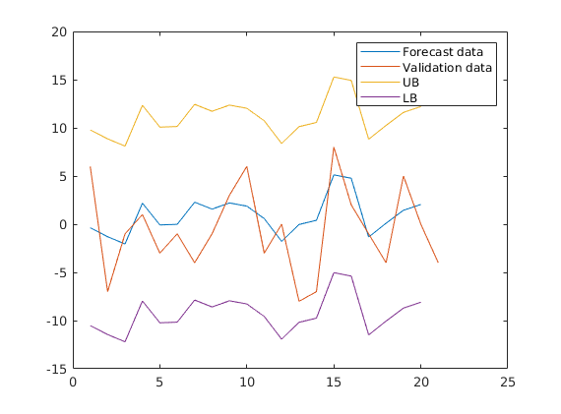
Forecast
MSE: 26.83 STD: 5.1798
RSS: 1.7235e+04

Slide 11
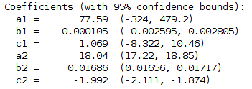
Non-Stationary Model
Curve a1*sin(b1*x+c1) + a2*sin(b2*x+c2) was fitted and RMSE = 7.2470
ARMA(2n,2n-1) Technique, F-test was used on the detrended data.
AR(3) model is adequate and RSS is 1.6763e+04

Slide 12
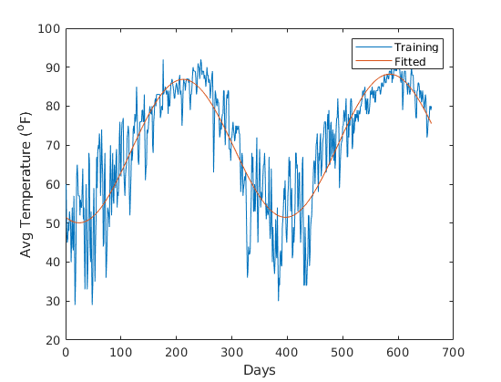
Deterministic trend

Slide 13
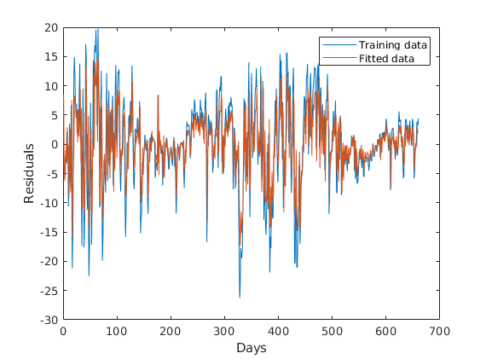
Detrended data

Slide 14
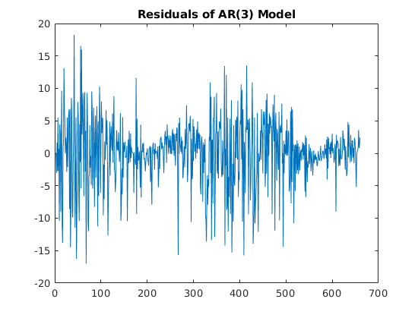
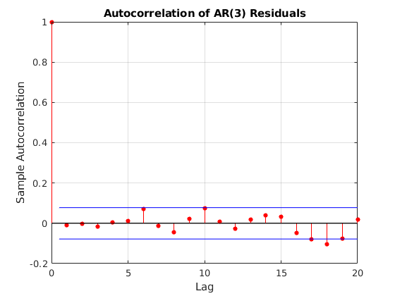
Residual Correlation

Slide 15
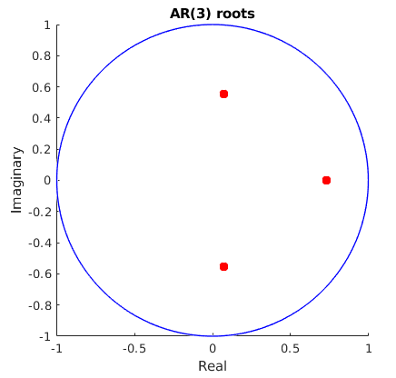
Auto-regressive roots
Out of 3 roots, 1 roots are real and 2 are complex.
1 root is 0.7345 so stochastic trend was not checked
Complex roots give period 4.3701 ≅ 4 or 4.5. Seasonality was checked and it was found that it does not exists.

Slide 16
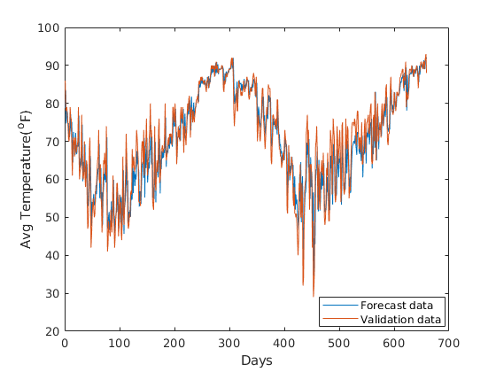
Forecast
AR(3) model along with the deterministic trend a1*sin(b1*x+c1) + a2*sin(b2*x+c2) was used.

Slide 17
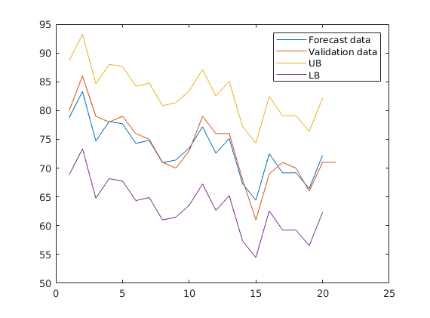
Forecast
MSE: 25.69 STD: 5.0685
RSS: 1.6550e+04

Slide 18
ARMAV
Percentage humidity along with temperature data was used.
Model was selected based on (n,n,n-1) modelling strategy with AIC criterion
For temperature as the output, we get (25,25,24) as the optimum model with RSS = 1.1785e+04 and for humidity as the output, we get (23,23,22) as the optimum model with RSS = 3.9469e+04

Slide 19
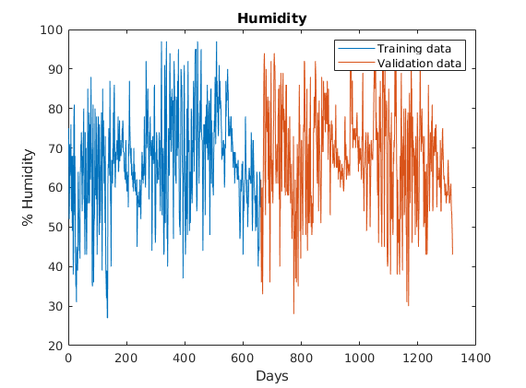
Humidity Data of Austin

Slide 20
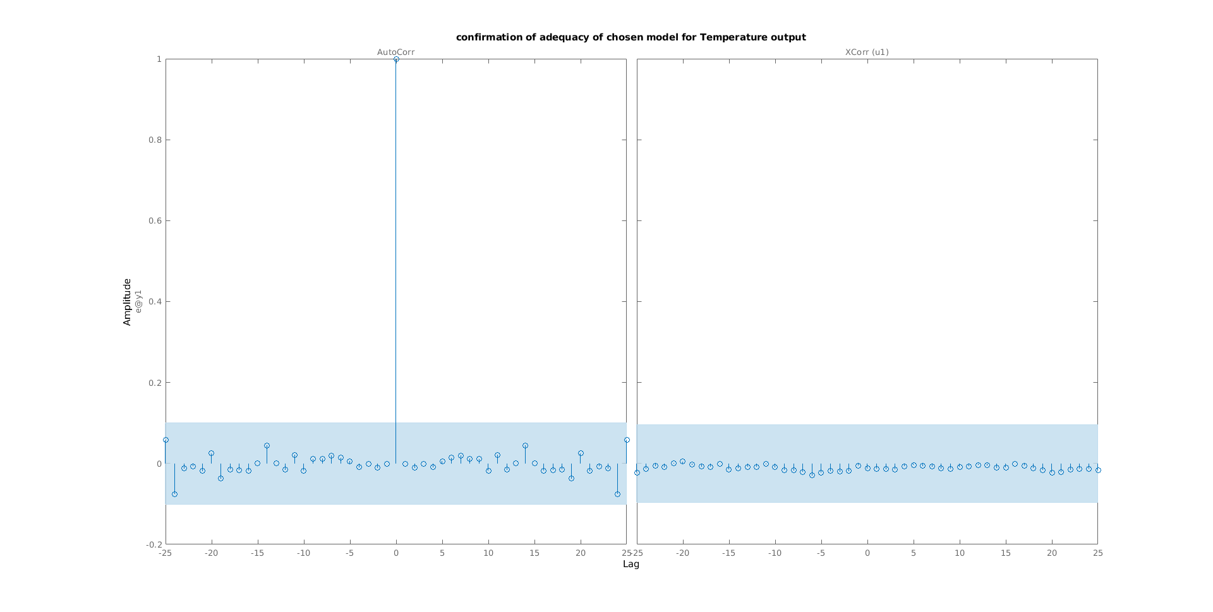
Residuals

Slide 21
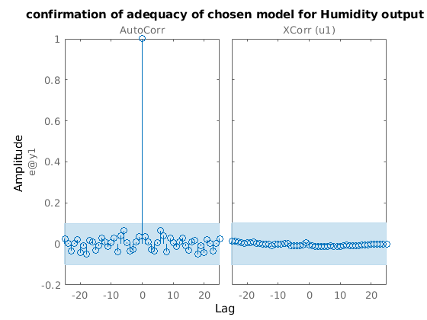
Residuals

Slide 22
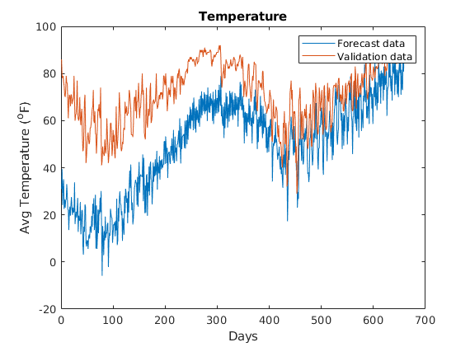
Temperature Forecast
MSE: 17.86 , STD = 4.2261
RSS = 4.3771e+05

Slide 23
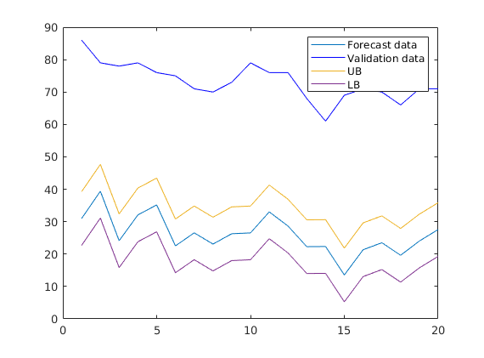
Temperature Forecast
MSE: 17.86 , STD = 4.2261

Slide 24
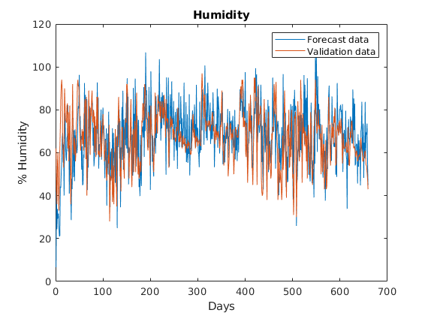
Humidity Forecast
MSE: 59.8 , STD = 7.7330
RSS = 1.3996e+05

Slide 25
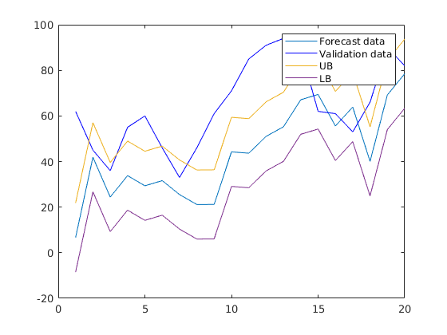
Humidity Forecast
MSE: 59.8 , STD = 7.7330

Slide 26
Conclusion
Among the models, Non-stationary model seems to be the best model as it has the lowest forecast RSS of 1.6550e+04.
ARMAV model under performs compared to other models which needs to be analysed.
Should try n-step prediction like weekly prediction and compare with theory.

